Slide 1
Go/No-go design based on dual-criterion
June 2024

Slide 2
Introduction
CONTENT
01
02
Binary Endpoint
03
TTE Endpoint
04
Summary

Slide 3
Introduction
01

Slide 4
Proof-of-Concept (POC)
POC is a milestone in drug development, as it is the first formal evaluation of the drug. Normally one of the following decisions will be made.
  Go ---- proceed to next stage development
  No-go ---- stop further development
  Need more information
A good POC should answer the following：
  Benefit ---- inference regarding the treatment effect
  Risk ---- making wrong decision
  Early stop ---- either efficacy or futility, meaningful interim analysis
Commonly used design for POC:
  Hypothesis testing-based design
  Dual-criterion Design
  Precision-based design

Slide 5

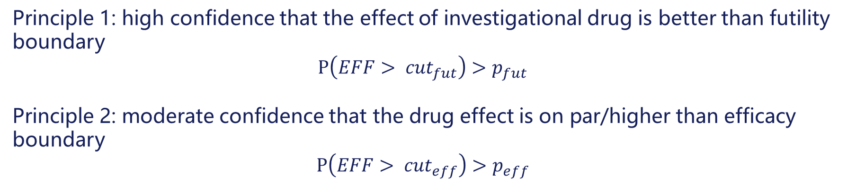

Dual-criterion Design
Dual-criterion design investigate two questions:
  Q1(Significance): dose the drug work at all?
  Q2(Relevance): dose the drug have a relevant clinical effect?
Futility boundary
$$({cut}_{fut})$$
Efficacy boundary
(${cut}_{eff})$
Treatment better
MCID
Principle 1: high confidence that the effect of investigational drug is better than futility boundary
$$P\left(EFF> {cut}_{fut}\right)>p_{fut}$$
Principle 2: moderate confidence that the drug effect is on par/higher than efficacy boundary
$$P\left(EFF> {cut}_{eff}\right)>p_{eff}$$

Slide 6


Dual-criterion Design
Decision table
 |  | Principle 2 (Efficacy signal)
 |  | Yes | No
Principle 1 (Superiority to futility) | Yes | Go | Equivocal
 | No | Seek more data* | No-go
*Ideally, these two principles are progressive. In practice, data can demonstrate efficacy signal without high confidence of superiority to futility boundary, which often indicating high variation due to insufficient information, or unreasonable choice of design parameters.
Futility boundary
$$({cut}_{fut})$$
Efficacy boundary
(${cut}_{eff})$
Treatment better
MCID

Slide 7
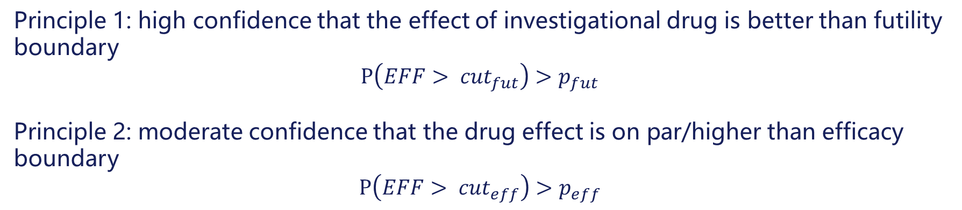
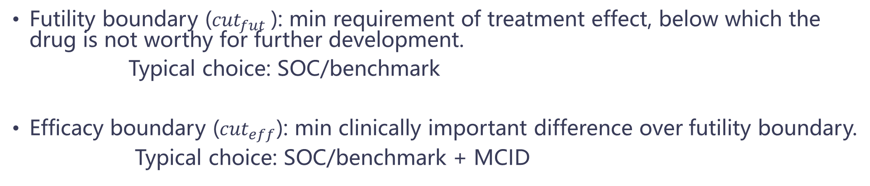
Dual-criterion Design
Design parameters —— effect boundary
Futility boundary (${cut}_{fut}$): min requirement of treatment effect, below which the drug is not worthy for further development.
Typical choice: SOC/benchmark
Efficacy boundary (${cut}_{eff}$): min clinically important difference over futility boundary.
Typical choice: SOC/benchmark + MCID
Principle 1: high confidence that the effect of investigational drug is better than futility boundary
$$P\left(EFF> {cut}_{fut}\right)>p_{fut}$$
Principle 2: moderate confidence that the drug effect is on par/higher than efficacy boundary
$$P\left(EFF> {cut}_{eff}\right)>p_{eff}$$

Slide 8
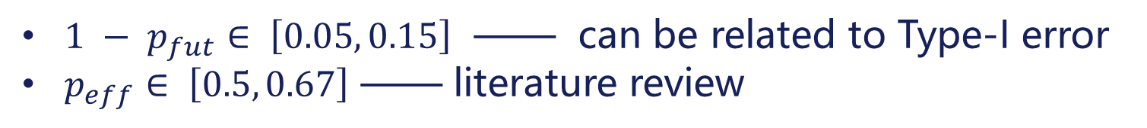
Dual-criterion Design
Design parameters —— signal strength
$1 − p_{fut}∈ \left[0.05, 0.15\right]$ —— can be related to Type-I error
$p_{eff}∈ \left[0.5, 0.67\right]$ —— literature review
Principle 1: high confidence that the effect of investigational drug is better than futility boundary
$$P\left(EFF> {cut}_{fut}\right)>p_{fut}$$
Principle 2: moderate confidence that the drug effect is on par/higher than efficacy boundary
$$P\left(EFF> {cut}_{eff}\right)>p_{eff}$$

Slide 9

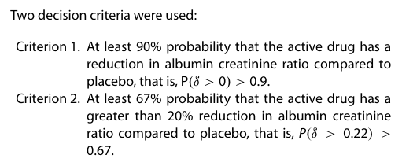
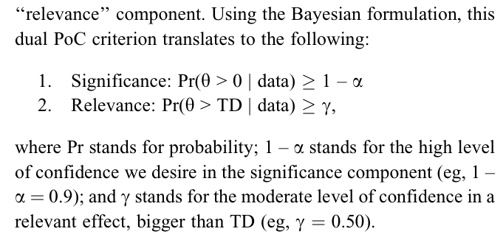
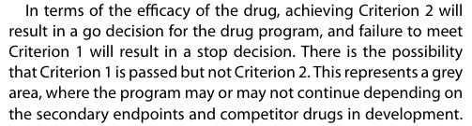
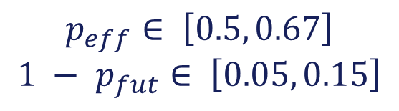
Dual-criterion Design
Signal strength —— literature review
Advantages of a wholly Bayesian approach to assessing efficacy in early drug development: a case study
Pharmaceutical Statistics, 2015
$$p_{eff}∈ \left[0.5, 0.67\right]$$
$$1 − p_{fut}∈ \left[0.05, 0.15\right]$$
Advantages of a wholly Bayesian approach to assessing efficacy in early drug development: a case study
Pharmaceutical Statistics, 2015
Bayesian Design of Proof-of Concept Trials
Therapeutic Innovation & Regulatory Science, 2014

Slide 10
Binary Endpoint
02

Slide 11
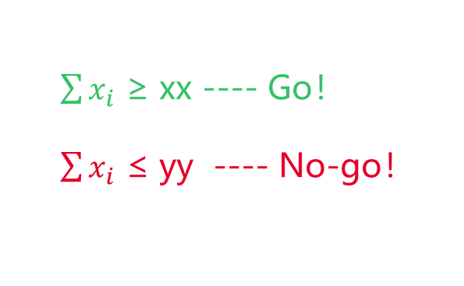
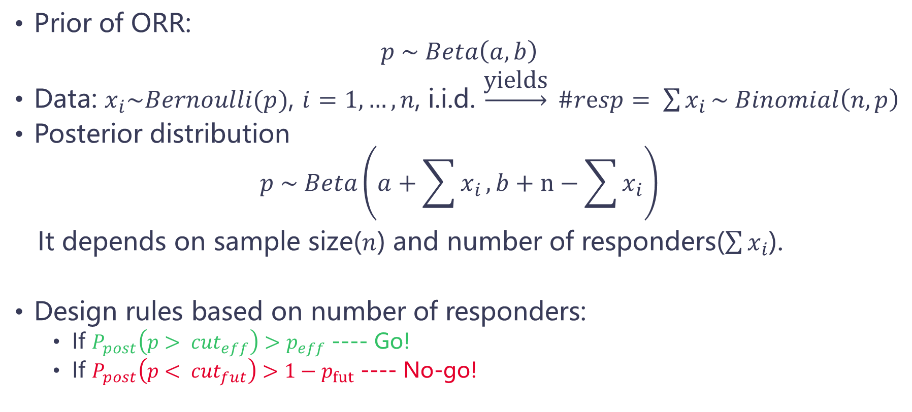
Binary Endpoint
Prior of ORR:
$$p \sim Beta\left(a, b\right)$$
Data: $x_{i}\sim Bernoulli(p)$, $i=1, …, n$, i.i.d. $\underset{→}{\text{yields}} \#resp= \sum{x_{i}}\sim Binomial\left(n, p\right)$
Posterior distribution
$$p \sim Beta\left(a+\sum{x_{i}}, b+n−\sum{x_{i}}\right)$$
It depends on sample size($n$) and number of responders($\sum{x_{i}}$).
Design rules based on number of responders:
  If $P_{post}\left(p> {cut}_{eff}\right)>p_{eff}$ ---- Go!
  If $P_{post}\left(p< {cut}_{fut}\right)>1−p_{fut}$ ---- No-go!
$\sum{x_{i}}$ ≥ xx ---- Go！
$\sum{x_{i}}$ ≤ yy ---- No-go！

Slide 12
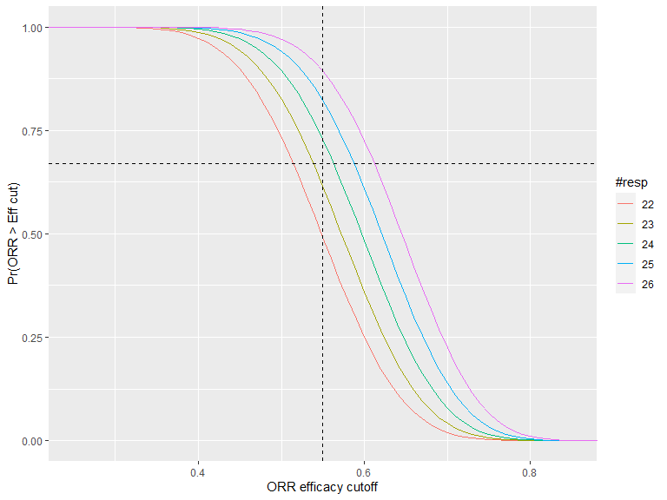
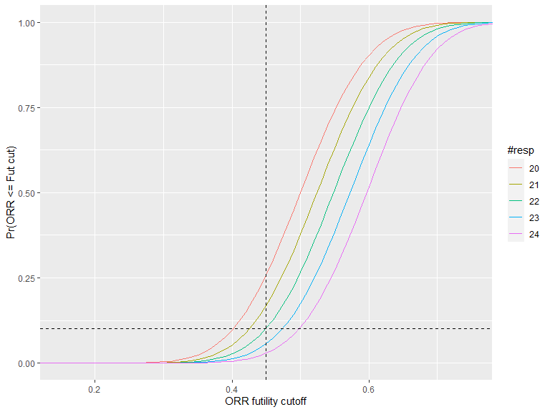
Binary Endpoint
Example: $n$ = 40, ${cut}_{eff}$ = 0.55, ${cut}_{fut}$ = 0.45, $p_{eff}$ = 0.67, $p_{fut}$ = 0.9
Go: $P_{post}\left(p>0.55\right)>0.67$ → #resp ≥ 24
No-go: $P_{post}\left(p<0.45\right)>0.1$ → #resp ≤ 22

Slide 13
Binary Endpoint
An example
A Ph I expansion PoC trial, IO treatment targeting PD-1 high NSCLC patients：
  Efficacy boundary 0.55, futility boundary 0.45;
  Sample size 40;
  Non-informative prior beta(1, 1);
  Posterior Pr(ORR ≥ 0.55) ≥ 67% ---- Declare Go
  Posterior Pr(ORR ≤ 0.45) ≥ 10% ---- Declare No-go
Decision rules
  If #resp ≥ 24 (Obs ORR ≥60%), then declare Go, with Pr(ORR ≥ 0.55)=72.8%.
  If #resp ≤ 22 (Obs ORR ≤ 55%), then declare No-go, with Pr(ORR ≤ 0.45)=10.2%.

Slide 14
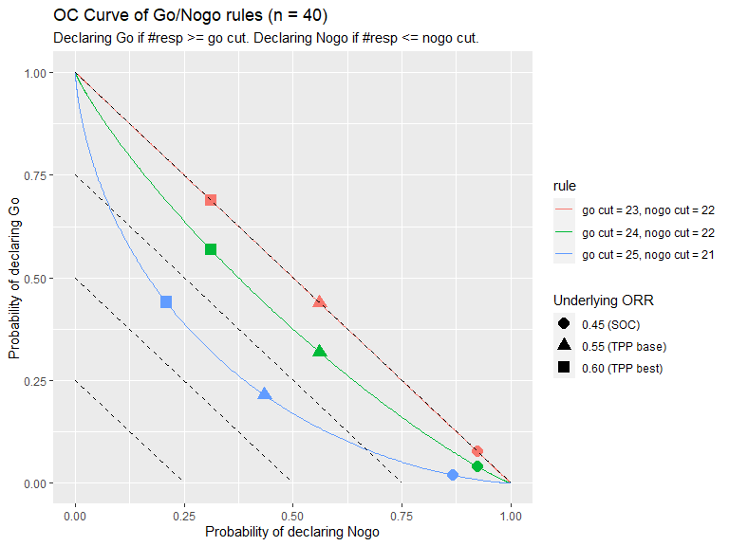
Binary Endpoint
Operating characteristics(OC)
OC according to the following rule：
Go：when #resp ≥ 24,
No-go：when #resp ≤ 22.
Gray area*：#resp btw 23
ORR | Pr(Go) | Pr(No-go) | Pr(Gray area*)
0.45 | 4.1% | 92.3% | 3.6%
0.55 | 31.9% | 56.1% | 12.1%
0.60 | 56.8% | 31.1% | 12.0%
* Other information e.g. PK/PD should be considered to make decision.

Slide 15
TTE Endpoint
03

Slide 16
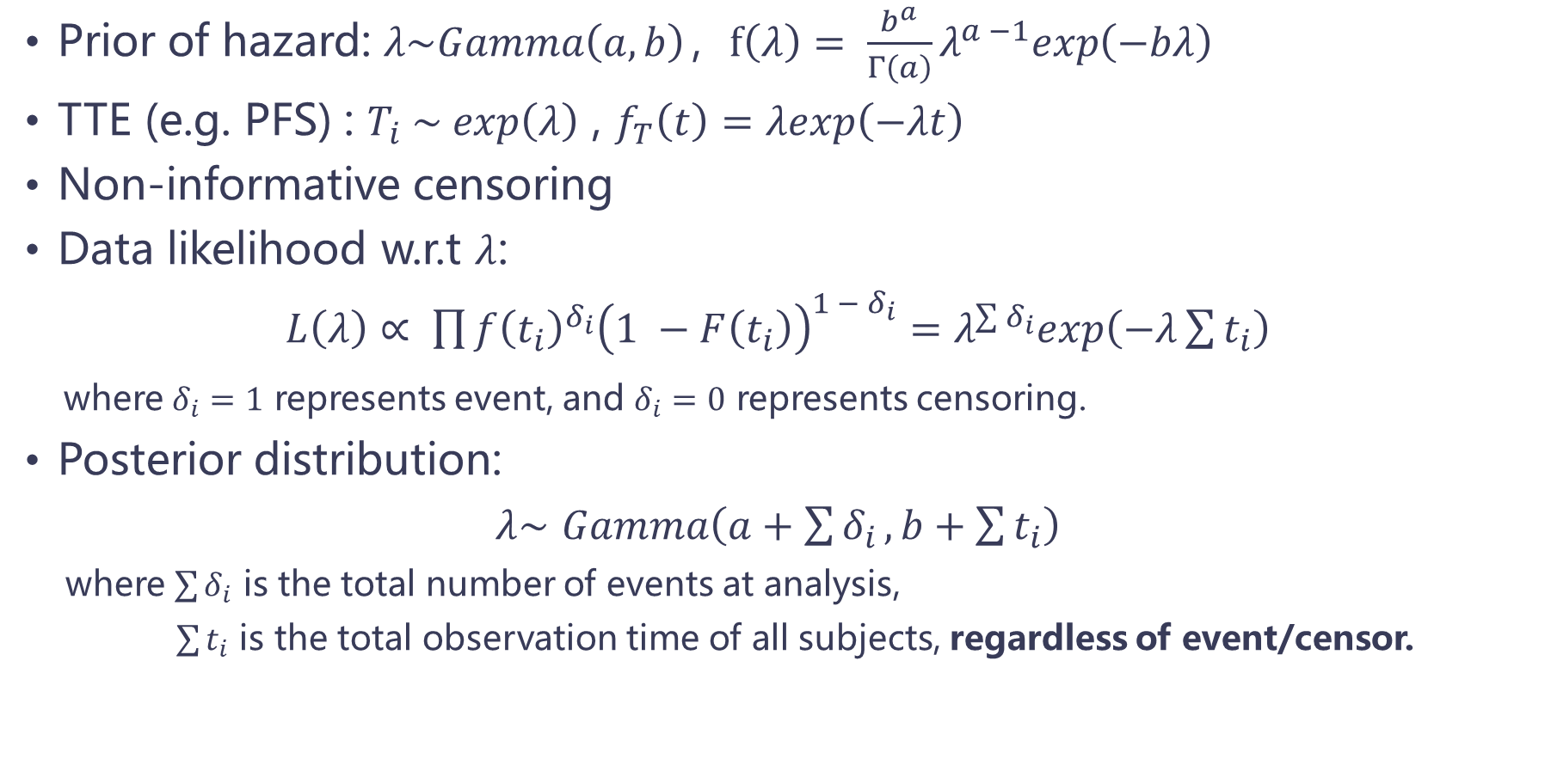
TTE Endpoint
Prior of hazard: $λ\sim Gamma\left(a, b\right)$，$f\left(λ\right)= \frac{b^{a}}{Γ\left(a\right)}λ^{a −1}exp\left(−bλ\right)$
TTE (e.g. PFS) : $T_{i} \sim exp\left(λ\right)$ , $f_{T}\left(t\right)=λexp\left(−λt\right)$
Non-informative censoring
Data likelihood w.r.t $λ$:
$L\left(λ\right)∝ \prod{{f\left(t_{i}\right)}^{δ_{i}}{\left(1 −F\left(t_{i}\right)\right)}^{1 − δ_{i}}}=λ^{\sum{δ_{i}}}exp\left(−λ\sum{t_{i}}\right)$
where $δ_{i}=1$ represents event, and $δ_{i}=0$ represents censoring.
Posterior distribution:
$λ\sim$ $Gamma\left(a+\sum{δ_{i}},b+\sum{t_{i}}\right)$
where $\sum{δ_{i}}$ is the total number of events at analysis,
$\sum{t_{i}}$ is the total observation time of all subjects, regardless of event/censor.

Slide 17
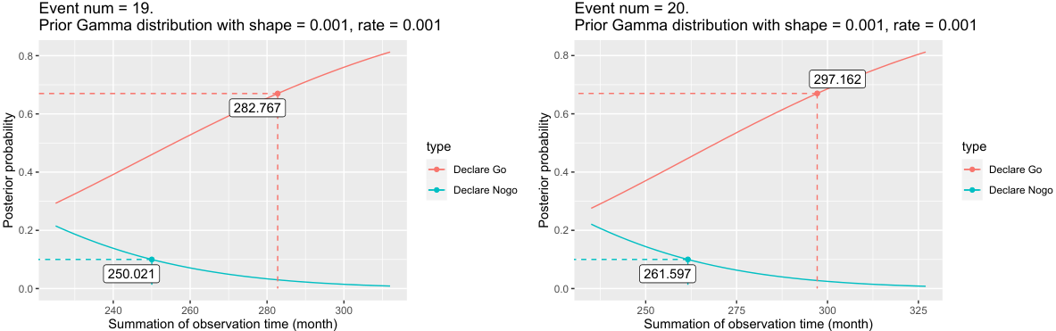
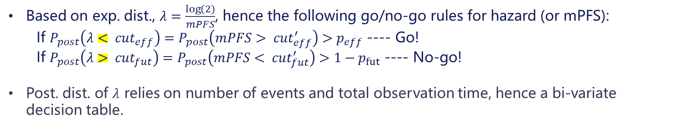
TTE Endpoint
Based on exp. dist., $λ=\frac{\log\left(2\right)}{mPFS}$, hence the following go/no-go rules for hazard (or mPFS):
  If $P_{post}\left(λ< {cut}_{eff}\right)=P_{post}\left(mPFS> {cut}_{eff}^{′}\right)>p_{eff}$ ---- Go!
  If $P_{post}\left(λ> {cut}_{fut}\right)=P_{post}\left(mPFS< {cut}_{fut}^{′}\right)>1−p_{fut}$ ---- No-go!
  Post. dist. of $λ$ relies on number of events and total observation time, hence a bi-variate decision table.
……
……

Slide 18
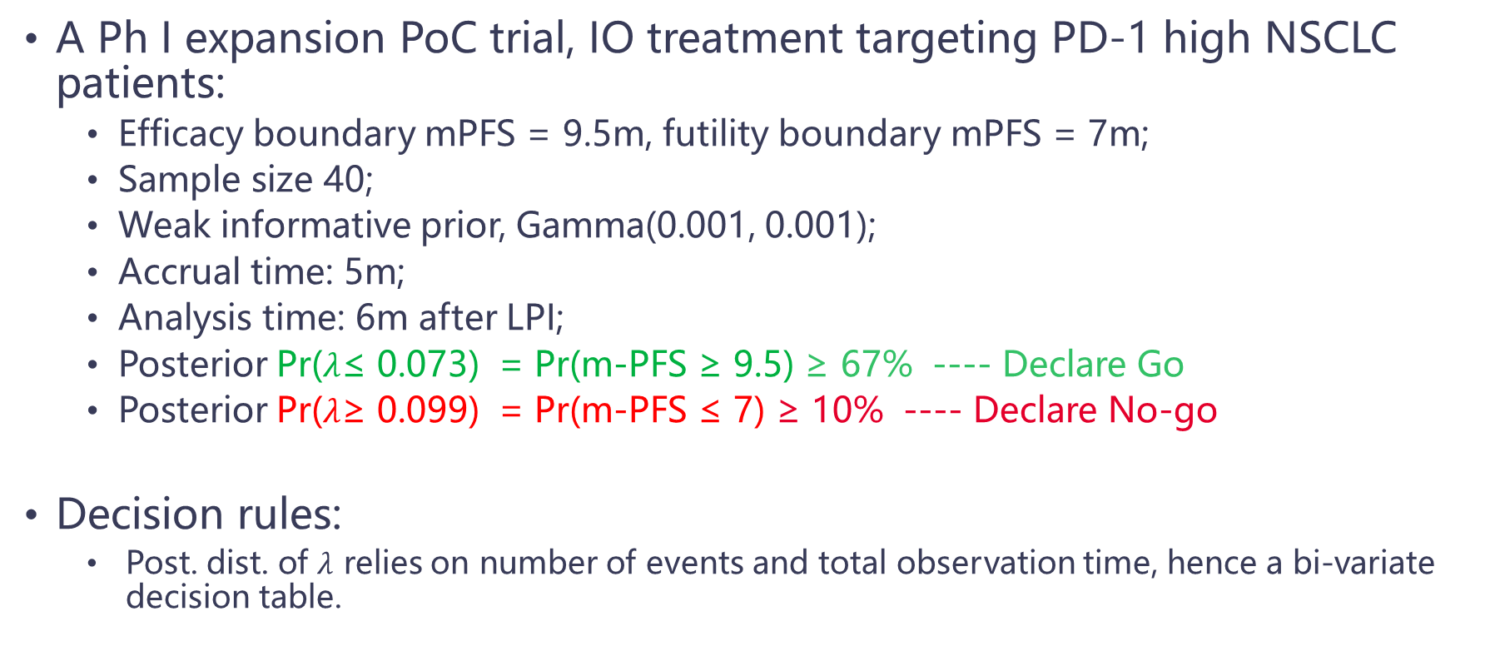
TTE Endpoint
Example 1
A Ph I expansion PoC trial, IO treatment targeting PD-1 high NSCLC patients:
  Efficacy boundary mPFS = 9.5m, futility boundary mPFS = 7m;
  Sample size 40;
  Weak informative prior, Gamma(0.001, 0.001);
  Accrual time: 5m;
  Analysis time: 6m after LPI;
  Posterior Pr($λ$≤ 0.073) = Pr(m-PFS ≥ 9.5) ≥ 67% ---- Declare Go
  Posterior Pr($λ$≥ 0.099) = Pr(m-PFS ≤ 7) ≥ 10% ---- Declare No-go
Decision rules:
    Post. dist. of $λ$ relies on number of events and total observation time, hence a bi-variate decision table.

Slide 19
TTE Endpoint
Decision table
Observed PFS events | No-go Criteria (Months)* | Go Criteria (Months)* | Not-determined (Months)
… | …
26 | ≤330 | ≥384 | 330 – 384
25 | ≤318 | ≥369 | 318 – 369
24 | ≤307 | ≥355 | 307 – 355
23 | ≤296 | ≥341 | 296 – 341
22 | ≤284 | ≥326 | 284 – 326
21 | ≤273 | ≥312 | 273 – 312
20 | ≤261 | ≥298 | 261 – 298
19 | ≤250 | ≥283 | 250 – 283
18 | ≤238 | ≥269 | 238 – 269
17 | ≤226 | ≥254 | 226 – 254
16 | ≤215 | ≥240 | 215 – 240
15 | ≤203 | ≥225 | 203 – 225
14 | ≤191 | ≥211 | 191 – 211
… | …
*: total observation time of all subjects, regardless of event/censor.

Slide 20
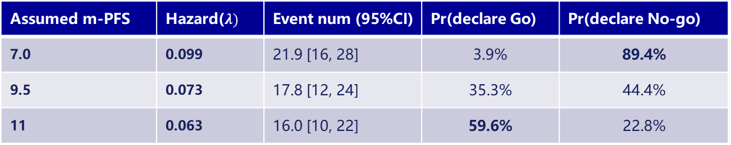
TTE Endpoint
操作特性(OC)
Assumed m-PFS | Hazard($λ)$ | Event num (95%CI) | Pr(declare Go) | Pr(declare No-go)
7.0 | 0.099 | 21.9 [16, 28] | 3.9% | 89.4%
9.5 | 0.073 | 17.8 [12, 24] | 35.3% | 44.4%
11 | 0.063 | 16.0 [10, 22] | 59.6% | 22.8%

Slide 21
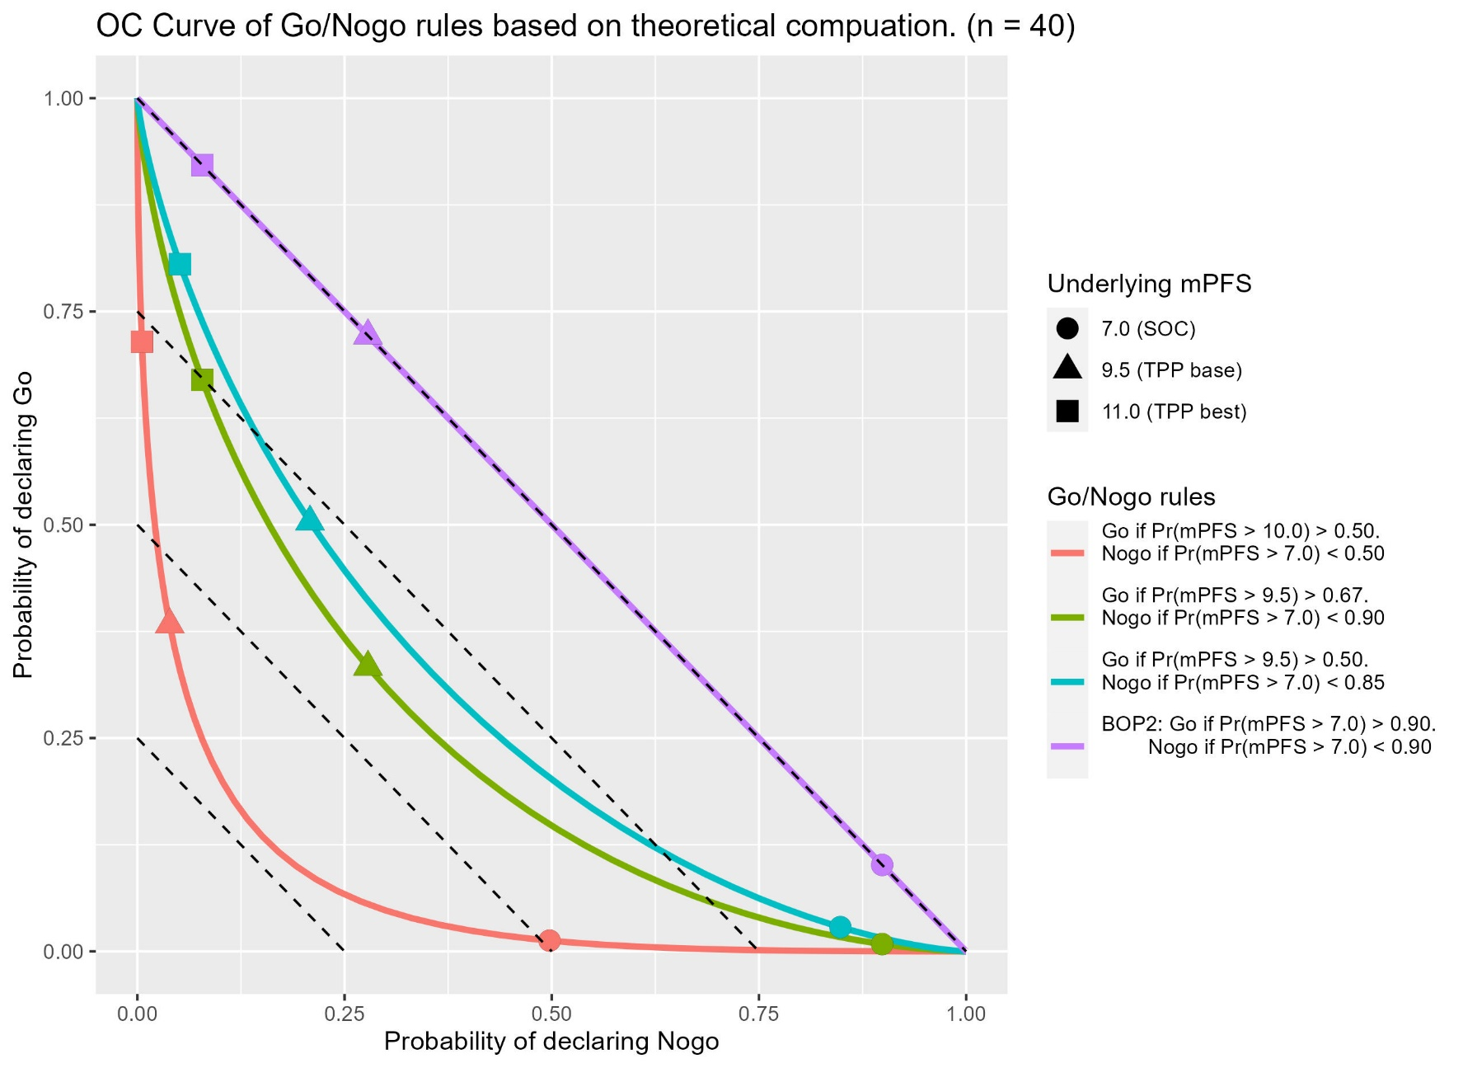
TTE Endpoint
Operating characteristics(OC) based on theoretical computation

Slide 22
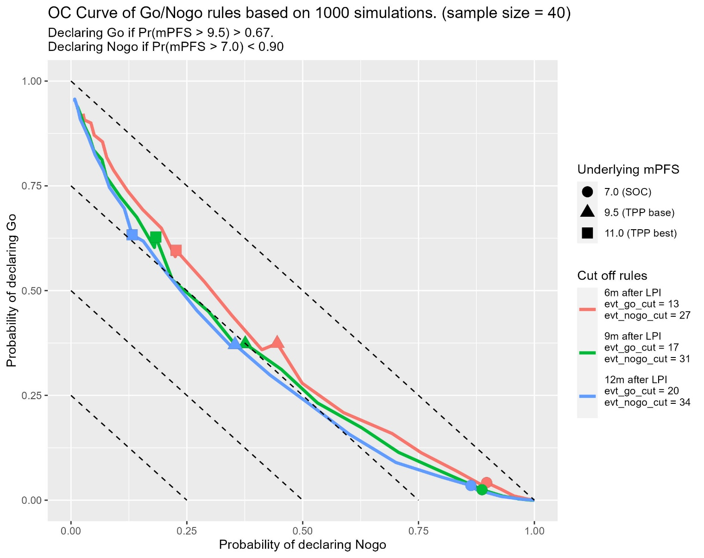
TTE Endpoint
Operating characteristics(OC) based on simulation

Slide 23
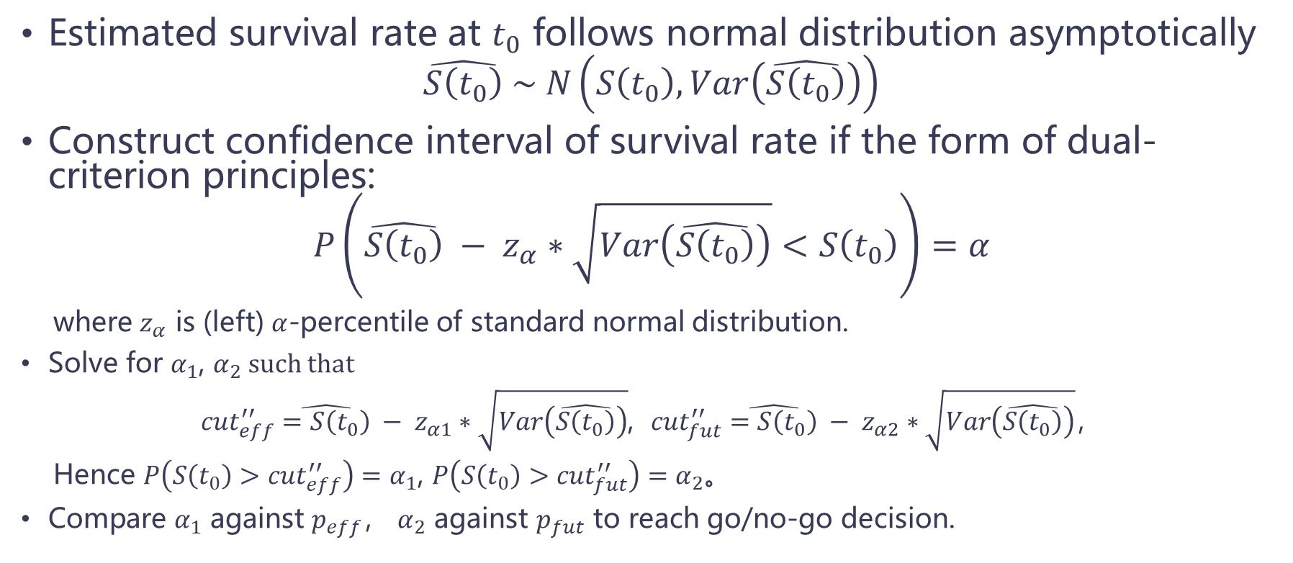
TTE Endpoint
Landmark survival rate
Estimated survival rate at $t_{0}$ follows normal distribution asymptotically
$$\hat{S\left(t_{0}\right)} \sim N\left(S\left(t_{0}\right), Var\left(\hat{S\left(t_{0}\right)}\right)\right)$$
Construct confidence interval of survival rate if the form of dual-criterion principles:
$$P\left(\hat{S\left(t_{0}\right)} − z_{α}∗\sqrt{Var\left(\hat{S\left(t_{0}\right)}\right)}<S\left(t_{0}\right)\right)=α$$
where $z_{α}$ is (left) $α$-percentile of standard normal distribution.
Solve for $α_{1}$, $α_{2}$ such that
${cut}_{eff}^{′′}\hat{=S\left(t_{0}\right)} − z_{α1}∗\sqrt{Var\left(\hat{S\left(t_{0}\right)}\right)}$, ${cut}_{fut}^{′′}\hat{=S\left(t_{0}\right)} − z_{α2}∗\sqrt{Var\left(\hat{S\left(t_{0}\right)}\right)}$，
Hence $P\left(S\left(t_{0}\right)>{cut}_{eff}^{′′}\right)=α_{1}$, $P\left(S\left(t_{0}\right)>{cut}_{fut}^{′′}\right)=α_{2}$。
Compare $α_{1}$ against $p_{eff}$， $α_{2}$ against $p_{fut}$ to reach go/no-go decision.

Slide 24
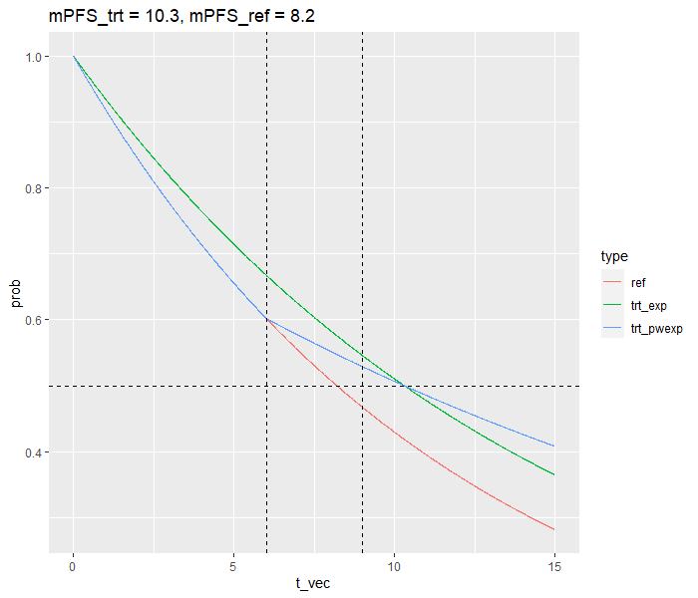
TTE Endpoint
Example 2
Background：
  Efficacy boundary mPFS = 10.3m;
  Futility boundary mPFS = 8.2m;
  Sample size 40;
  Accrual time: 5m;
  Analysis time: 6m
Underlying PFS distribution:
piecewise exponential distribution,
change point at 6m

Slide 25
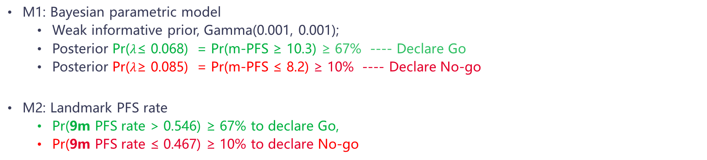
TTE Endpoint
Example 2
M1: Bayesian parametric model
  Weak informative prior, Gamma(0.001, 0.001);
  Posterior Pr($λ$≤ 0.068) = Pr(m-PFS ≥ 10.3) ≥ 67% ---- Declare Go
  Posterior Pr($λ$≥ 0.085) = Pr(m-PFS ≤ 8.2) ≥ 10% ---- Declare No-go
M2: Landmark PFS rate
  Pr(9m PFS rate > 0.546) ≥ 67% to declare Go,
  Pr(9m PFS rate ≤ 0.467) ≥ 10% to declare No-go
Underlying mPFS | Cut off rule | Analysis time (95%CI) (Months) | Event num (95%CI) | Pr(M1 Go) | Pr(M1 No-go) | Pr(M2 Go) | Pr(M2 No-go)
8.2 | 6m after LPI | 11 | 19.7 (14, 26) | 8.8% | 88.9% | 9.8% | 88.9%
10.3 | 6m after LPI | 11 | 17.9 (12, 24) | 21.0% | 75.5% | 26.6% | 70.0%
11.7 | 6m after LPI | 11 | 17.3 (11, 24) | 25.4% | 71.2% | 33.4% | 63.0%

Slide 26
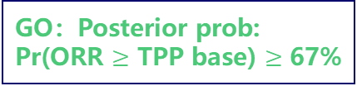
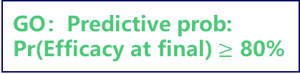
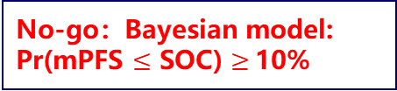
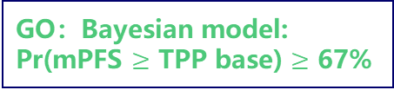

Decision Tree
GO：Predictive prob:
Pr(Efficacy at final) $≥$ 80%
GO：Posterior prob:
Pr(ORR $≥$ TPP base) $≥$ 67%
GO：Bayesian model:
Pr(mPFS $≥$ TPP base) $≥$ 67%
ORR
@20pts
Wait for ORR data
ORR
@40pts
Wait for PFS data
PFS
@40pts
Gray area：Consider more information
No-go：Predictive prob:
Pr(Efficacy at final) < 1%
No-go：Posterior prob:
Pr(ORR $≤$ SOC) $≥$10%
No-go：Bayesian model:
Pr(mPFS $≤$ SOC) $≥$10%
Treatment should demonstrate meaningful improvement --> Deserves to Go
Treatment 10% chance worse than SOC --> No-go
If want to make decision based on PD events, then censor rate must be controlled.
Notes:
ORR 40pts 67%

Slide 27
Summary
04

Slide 28
Summary
Dual-criterion design is a commonly used design for PoC trial. It combines information from both medical and statistical perspectives.
Dual-criterion design is flexible. It can be applied to SAT/RCT, different endpoints, etc. It can be combined with other designs such as BOP2, non-inferiority, etc.
Choose of efficacy/futility boundary is a teamwork, also a learning/improving process of the TPP.
It is always hard to make decision for treatment effect just at effect boundary.
Sample size, sensitivity of decision rules and treatment difference are impossible triangular.

Slide 29
Reference
Advantages of a wholly Bayesian approach to assessing efficacy in early drug development: a case study，Pharmaceutical Statistics, 2015
Bayesian Design of Proof-of Concept Trials，Therapeutic Innovation & Regulatory Science, 2014
Beyond p-values: A phase II dual-criterion design with statistical significance and clinical relevance. Clinical Trials. 2018
BOP2: Bayesian optimal design for phase II clinical trials with simple and complex endpoints. Stat Med. 2017
Bayesian optimal phase II clinical trial design with time-to-event endpoint. Pharm Stat. 2020
Proof of Concept: Drug Selection? Or Dose Selection? Thoughts on Multiplicity Issues. Ther Innov Regul Sci. 2021

Slide 32
Go/No-go ORR
#Pts. | Observed ORR | 95% CI | Predictive Probability of declaring efficacy
20 | 7 (0.35) | 0.15 – 0.59 | 0.1%
20 | 8 (0.40) | 0.19 – 0.64 | 0.7%
20 | 9 (0.45) | 0.23 – 0.69 | 3.8%
20 | … | … | …
20 | 13 (0.65) | 0.41 - 0.85 | 77.8%
20 | 14 (0.70) | 0.46 - 0.89 | 92.0%
20 | 15 (0.75) | 0.51 - 0.91 | 98.0%
#Pts. | Observed ORR | 95% CI | Posterior probability
 |  |  | Pr(ORR > 0.55) | Pr(ORR < 0.45)
40 | 20 (0.50) | 0.34 – 0.66 | 25.9% | 25.9%
40 | 21 (0.53) | 0.36 – 0.68 | 36.9% | 16.9%
40 | 22 (0.55) | 0.38 – 0.71 | 49.2% | 10.2%
40 | 23 (0.58) | 0.41 – 0.73 | 61.5% | 5.7%
40 | 24 (0.60) | 0.43 – 0.75 | 72.8% | 2.9%
40 | 25 (0.63) | 0.46 – 0.77 | 82.3% | 1.4%
40 | 26 (0.65) | 0.48 – 0.79 | 89.3% | 0.6%
40 | 27 (0.68) | 0.51 – 0.81 | 94.1% | 0.2%
40 | 28 (0.70) | 0.53 – 0.83 | 97.1% | 0.1%

Slide 33
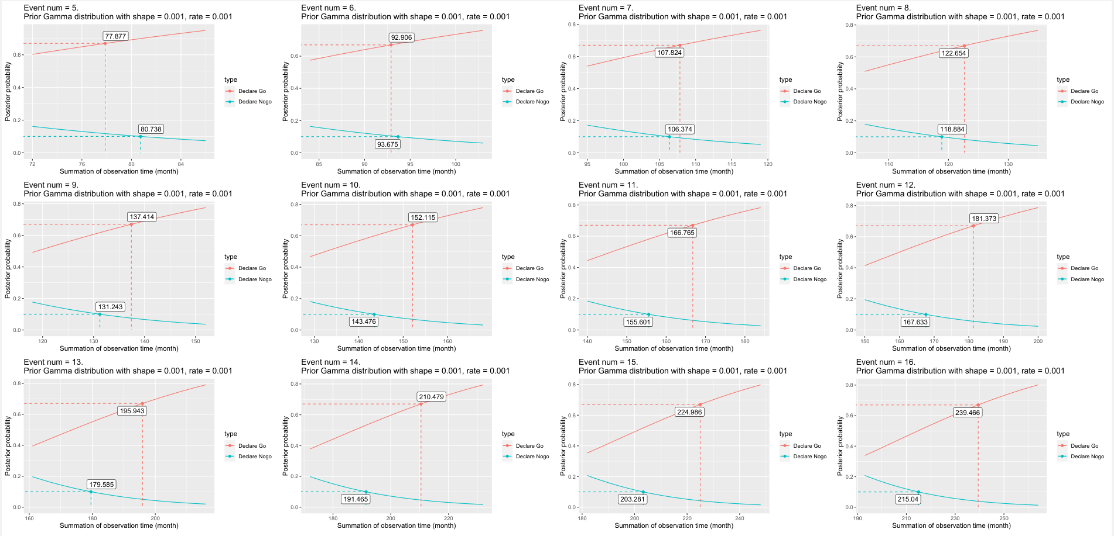
TTE endpoint – Find rules

Slide 34
Compare PFS go/nogo design - Conclusion
Method 1. Based on Bayesian parametric model
  Pr($λ$≤ 0.068) = Pr(m-PFS ≥ 10.3[TPP base] ) ≥ 0.67 to declare Go,
  Pr($λ$≤ 0.085) = Pr(m-PFS ≥ 8.2[SOC] ) < 0.9 to declare No-go
Method 2. Based on KM estimator of PFS rate at given month
  Pr(6m PFS rate > 0.668[TPP base] ) ≥ 0.67 to declare Go,
  Pr(6m PFS rate ≥ 0.602[SOC] ) < 0.9 to declare No-go
Conclusions:
M1 is better under exponential distribution. But in real life it is often violated.
M1 is suitable for continuous monitoring and can provide a decision table.
M2 is suitable for when we know for sure the PFS rate can be distinguished at X month. This needs support from CS.
Using mPFS and converting to hazard of exponential distribution or X-month PFS rate is always somewhat risky.
Longer follow-up time, larger sample size are better for performance of both methods.

Slide 35
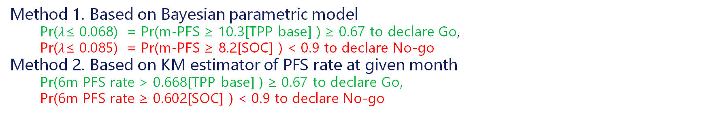
Compare PFS go/nogo design – Setting 1
Method 1. Based on Bayesian parametric model
  Pr($λ$≤ 0.068) = Pr(m-PFS ≥ 10.3[TPP base] ) ≥ 0.67 to declare Go,
  Pr($λ$≤ 0.085) = Pr(m-PFS ≥ 8.2[SOC] ) < 0.9 to declare No-go
Method 2. Based on KM estimator of PFS rate at given month
  Pr(6m PFS rate > 0.668[TPP base] ) ≥ 0.67 to declare Go,
  Pr(6m PFS rate ≥ 0.602[SOC] ) < 0.9 to declare No-go
Settings:
Exponential survival time
6m follow up time
Results: M1 better than M2 since M1 specify the model correctly.
m-PFS | Cut off rule | Analysis time (95%CI) (Months) | Event num (95%CI) | Pr(M1 Go) | Pr(M1 No-go) | Pr(M2 Go) | Pr(M2 No-go)
8.2 | 6m after LPI | 11 | 19.8 (14, 26) | 8.9% | 89.0% | 9.7% | 89.4%
10.3 | 6m after LPI | 11 | 16.8 (11, 23) | 35.6% | 59.8% | 32.8% | 65.5%
11.7 | 6m after LPI | 11 | 15.3 (11, 23) | 56.1% | 39.0% | 50.6% | 47.5%
8.2 | 16 PFS event | 8.7 (6.0, 12.4) | 16 | 7.3% | 90.4% | 9.5% | 89.9%
10.3 | 16 PFS event | 10.3 (6.9, 14.9) | 16 | 32.1% | 63.3% | 32.8% | 65.9%
11.7 | 16 PFS event | 11.4 (7.4, 16.7) | 16 | 52.5% | 42.5% | 50.1% | 48.2%

Slide 36
Compare PFS go/nogo design – Setting 2
Method 1. Based on Bayesian parametric model
  Pr($λ$≤ 0.068) = Pr(m-PFS ≥ 10.3[TPP base] ) ≥ 0.67 to declare Go,
  Pr($λ$≤ 0.085) = Pr(m-PFS ≥ 8.2[SOC] ) < 0.9 to declare No-go
Method 2. Based on KM estimator of PFS rate at given month
  Pr(6m PFS rate > 0.668[TPP base] ) ≥ 0.67 to declare Go,
  Pr(6m PFS rate ≥ 0.602[SOC] ) < 0.9 to declare No-go
Settings :
Piecewise exponential survival time
6m follow up time
Results: Performance of M1 drops compared to Setting1 since model misspecification.
M2 not working at all since no difference of 6m PFS rate under piecewise exponential setting.
m-PFS | Cut off rule | Analysis time (95%CI) (Months) | Event num (95%CI) | Pr(M1 Go) | Pr(M1 No-go) | Pr(M2 Go) | Pr(M2 No-go)
8.2 | 6m after LPI | 11 | 19.7 (14, 26) | 8.8% | 88.9% | 9.7% | 89.5%
10.3 | 6m after LPI | 11 | 17.9 (12, 24) | 21.0% | 75.5% | 10.0% | 89.2%
11.7 | 6m after LPI | 11 | 17.3 (11, 24) | 25.4% | 71.2% | 9.8% | 89.3%
8.2 | 16 PFS event | 8.8 (6.0, 12.4) | 16 | 7.7% | 90.0% | 9.7% | 89.8%
10.3 | 16 PFS event | 9.5 (6.0, 16.0) | 16 | 19.7% | 77.9% | 9.8% | 89.4%
11.7 | 16 PFS event | 10.0 (6.0, 18.7) | 16 | 25.1% | 72.8% | 9.8% | 89.6%

Slide 37
Compare PFS go/nogo design – Setting 3
Method 1. Based on Bayesian parametric model
  Pr($λ$≤ 0.068) = Pr(m-PFS ≥ 10.3[TPP base] ) ≥ 0.67 to declare Go,
  Pr($λ$≤ 0.085) = Pr(m-PFS ≥ 8.2[SOC] ) < 0.9 to declare No-go
Method 2. Based on KM estimator of PFS rate at given month
  Pr(9m PFS rate > 0.546[TPP base] ) ≥ 0.67 to declare Go,
  Pr(9m PFS rate ≥ 0.467[SOC] ) < 0.9 to declare No-go
Settings :
Piecewise exponential survival time
6m follow up time
Results: Performance of M1 drops compared to Setting1 due to model misspecification.
M2 slightly better than M1 due to its robustness.
m-PFS | Cut off rule | Analysis time (95%CI) (Months) | Event num (95%CI) | Pr(M1 Go) | Pr(M1 No-go) | Pr(M2 Go) | Pr(M2 No-go)
8.2 (SOC) | 6m after LPI | 11 | 19.7 (14, 26) | 8.8% | 88.9% | 9.8% | 88.9%
10.3 (Base) | 6m after LPI | 11 | 17.9 (12, 24) | 21.0% | 75.5% | 26.6% | 70.0%
11.7 (Best) | 6m after LPI | 11 | 17.3 (11, 24) | 25.4% | 71.2% | 33.4% | 63.0%
8.2 (SOC) | 16 PFS event | 8.8 (6.0, 12.4) | 20 | 7.7% | 90.0% | 9.2% | 88.8%
10.3 (Base) | 16 PFS event | 9.5 (6.0, 16.0) | 20 | 19.7% | 77.9% | 24.3% | 71.7%
11.7 (Best) | 16 PFS event | 10.0 (6.0, 18.7) | 20 | 25.1% | 72.8% | 30.7% | 64.7%

Slide 38
Compare PFS go/nogo design – Setting 4
Method 1. Based on Bayesian parametric model
  Pr($λ$≤ 0.068) = Pr(m-PFS ≥ 10.3[TPP base] ) ≥ 0.67 to declare Go,
  Pr($λ$≤ 0.085) = Pr(m-PFS ≥ 8.2[SOC] ) < 0.9 to declare No-go
Method 2. Based on KM estimator of PFS rate at given month
  Pr(9m PFS rate > 0.546[TPP base] ) ≥ 0.67 to declare Go,
  Pr(9m PFS rate ≥ 0.467[SOC] ) < 0.9 to declare No-go
Settings :
Piecewise exponential survival time
9m follow up time
Results: Performance of M1 drops compared to Setting1 since model misspecification.
Long follow up time favors M1, the drop of performance is less compared to that of Setting2.
m-PFS | Cut off rule | Analysis time (95%CI) (Months) | Event num (95%CI) | Pr(M1 Go) | Pr(M1 No-go) | Pr(M2 Go) | Pr(M2 No-go)
8.2 (SOC) | 9m after LPI | 14 | 23.7 (17, 30) | 7.0% | 89.0% | 7.8% | 90.1%
10.3 (Base) | 9m after LPI | 14 | 20.3 (14, 26) | 32.3% | 60.2% | 25.5% | 69.8%
11.7 (Best) | 9m after LPI | 14 | 19.2 (13, 26) | 42.3% | 49.9% | 32.4% | 62.2%
8.2 (SOC) | 20 PFS event | 11.1 (7.6, 15.7) | 20 | 6.2% | 90.1% | 7.9% | 90.0%
10.3 (Base) | 20 PFS event | 13.6 (7.7, 23.0) | 20 | 32.6% | 61.2% | 25.5% | 69.9%
11.7 (Best) | 20 PFS event | 15.3 (7.7, 28.4) | 20 | 45.2% | 49.2% | 32.7% | 61.5%

Slide 39
Compare PFS go/nogo design – Setting 5
Method 1. Based on Bayesian parametric model
  Pr($λ$≤ 0.068) = Pr(m-PFS ≥ 10.3[TPP base] ) ≥ 0.67 to declare Go,
  Pr($λ$≤ 0.085) = Pr(m-PFS ≥ 8.2[SOC] ) < 0.9 to declare No-go
Method 2. Based on KM estimator of PFS rate at given month
  Pr(12m PFS rate > 0.446[TPP base] ) ≥ 0.67 to declare Go,
  Pr(12m PFS rate ≥ 0.362[SOC] ) < 0.9 to declare No-go
Settings :
Piecewise exponential survival time
9m follow up time
Results: M2 can base on PFS rate later than follow up time.
After 12m, PFS rate difference from piecewise survival time is larger than that from exponential survival.
m-PFS | Cut off rule | Analysis time (95%CI) (Months) | Event num (95%CI) | Pr(M1 Go) | Pr(M1 No-go) | Pr(M2 Go) | Pr(M2 No-go)
8.2 (SOC) | 9m after LPI | 14 | 23.7 (17, 30) | 7.0% | 89.0% | 8.1% | 89.6%
10.3 (Base) | 9m after LPI | 14 | 20.3 (14, 26) | 32.3% | 60.2% | 41.9% | 52.9%
11.7 (Best) | 9m after LPI | 14 | 19.2 (13, 26) | 42.3% | 49.9% | 55.4% | 39.2%
8.2 (SOC) | 20 PFS event | 11.1 (7.6, 15.7) | 20 | 6.2% | 90.1% | 8.2% | 87.8%
10.3 (Base) | 20 PFS event | 13.6 (7.7, 23.0) | 20 | 32.6% | 61.2% | 39.4% | 54.3%
11.7 (Best) | 20 PFS event | 15.3 (7.7, 28.4) | 20 | 45.2% | 49.2% | 53.6% | 40.5%

Slide 40
Compare PFS go/nogo design – Setting 6
Method 1. Based on Bayesian parametric model
  Pr($λ$≤ 0.068) = Pr(m-PFS ≥ 10.3[TPP base] ) ≥ 0.67 to declare Go,
  Pr($λ$≤ 0.085) = Pr(m-PFS ≥ 8.2[SOC] ) < 0.9 to declare No-go
Method 2. Based on KM estimator of PFS rate at given month
  Pr(12m PFS rate > 0.446[TPP base] ) ≥ 0.67 to declare Go,
  Pr(12m PFS rate ≥ 0.362[SOC] ) < 0.9 to declare No-go
Settings :
Exponential survival time
9m follow up time
Results: Same as setting1, M1 is better than M2 even though M2 is trying to look for lager difference.
m-PFS | Cut off rule | Analysis time (95%CI) (Months) | Event num (95%CI) | Pr(M1 Go) | Pr(M1 No-go) | Pr(M2 Go) | Pr(M2 No-go)
8.2 (SOC) | 9m after LPI | 14 | 23.8 (18, 30) | 6.7% | 89.7% | 7.8% | 89.9%
10.3 (Base) | 9m after LPI | 14 | 20.6 (15, 27) | 34.4% | 55.9% | 32.5% | 63.2%
11.7 (Best) | 9m after LPI | 14 | 18.9 (13, 25) | 57.7% | 33.7% | 52.4% | 43.9%
8.2 (SOC) | 20 PFS event | 11.0 (7.6, 15.6) | 20 | 6.2% | 90.4% | 8.1% | 88.2%
10.3 (Base) | 20 PFS event | 13.4 (9.0, 19.2) | 20 | 32.4% | 58.5% | 31.8% | 63.4%
11.7 (Best) | 20 PFS event | 14.9 (9.8, 22.2) | 20 | 54.4% | 37.0% | 51.2% | 44.2%

